Slide 1
School Closure day – the Land of Roar Year 5
1. Enjoy the beginning of ‘The Land of Roar’- you can either listen on the you tube links or read on the e-book. ( go up to the part where grandad goes into the camp bed!!)
2. This is set in an attic- can you draw a detailed picture of an attic- with lots of old interesting things in? Think what is often stored in attics.
3. Then can you describe it. It might be dark and shadowy. Spiders? Full of dusty boxes….? Add in some characters… what are they doing in the attic at the start of the story? Looking for something? Clearing out? This would be a great story opener. Write a paragraph- use lots of adjectives.
3. You could plan a great story starting in an attic…. What would happen next? Draw as a cartoon story to tell the rest. You just need to draw some boxes and put each part of the story in each box. You can write a caption under each box to help explain the plot.

Slide 2
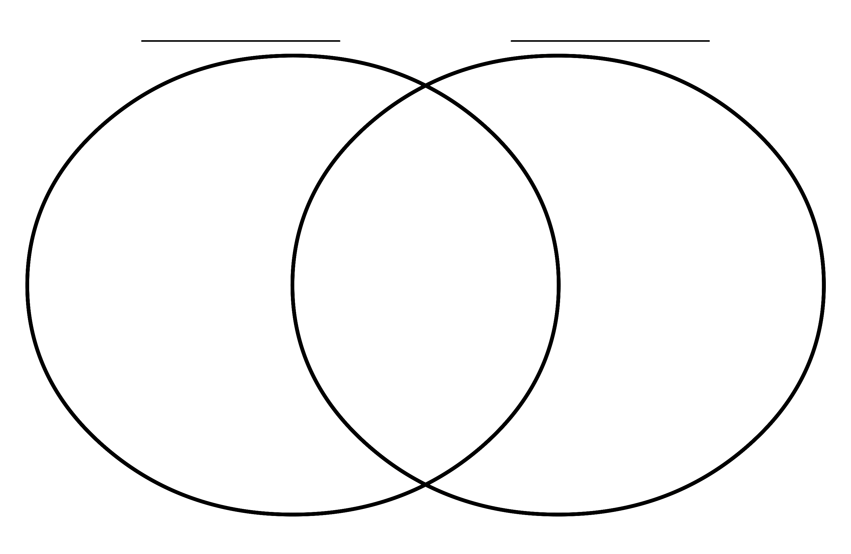
Think about the two characters in the Land of Roar- Rose and Arthur. How are they different and similar ? Record your ideas on this Venn diagram.
Rose
Arthur

Slide 3
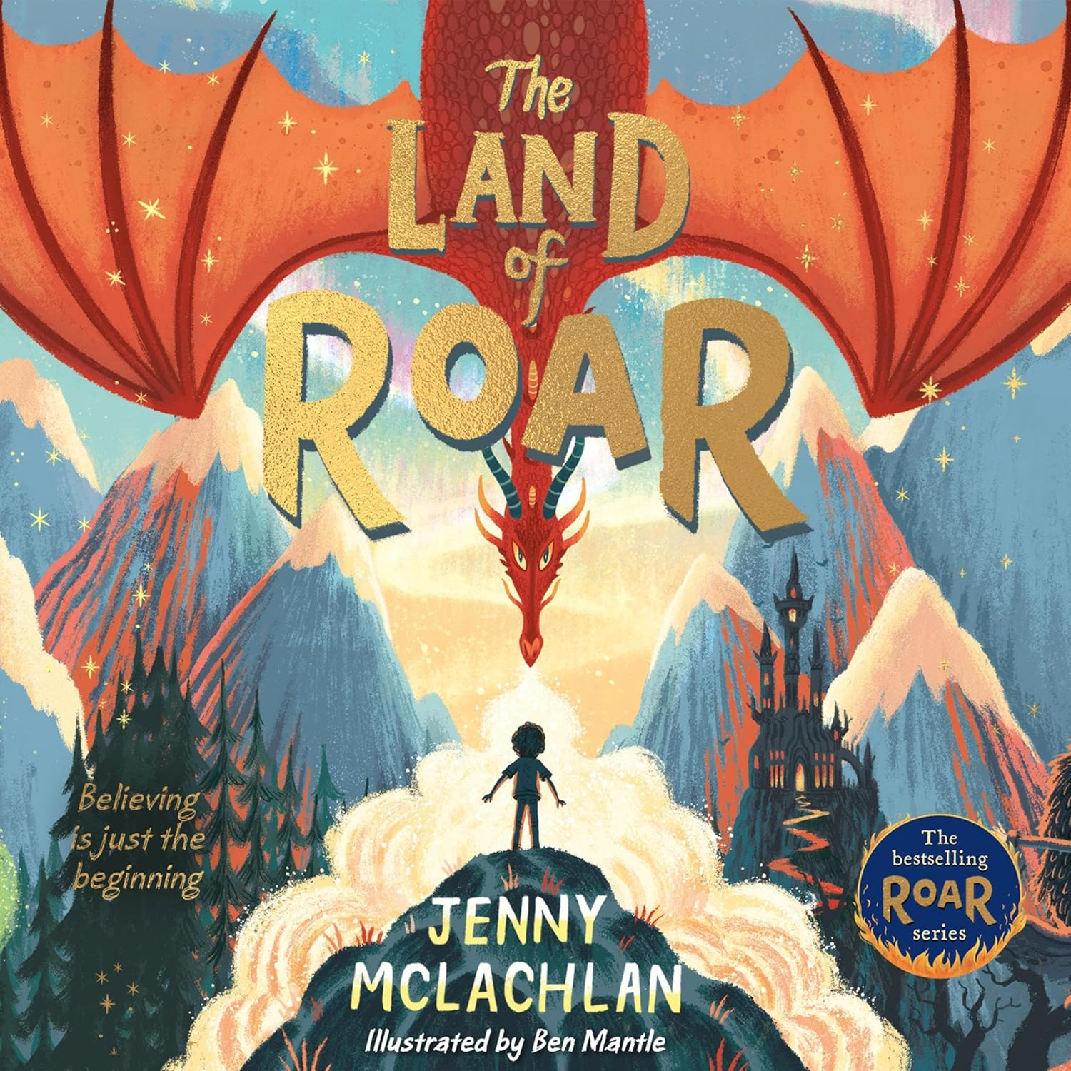
Front cover
What clues can you see in this front cover?
Have a really close look.
When you have written/ drawn your own story, starting from the attic… decide on a title for your book.
Now can you design a front cover- that gives some clues…. But doesn’t spoil any surprises. Try to make the cover detailed, with things in it- that make the reader curious!

Slide 4
The Land of Roar - Chapter 1
You tube links to the story being read aloud to you
Read from the screen using either of these
e books or use the you tube links on the left to hear the story read to you
TLOR Ch1
TLOR Ch2
TLOR Ch3
Read The Land of Roar online free by Jenny McLachlan
TLOR Ch4
The Land of Roar - Flip PDF | FlipBuilder
TLOR Ch5
TLOR Ch 6
TLOR Ch 7
TLOR Ch 8
TLOR Ch 9

