Slide 1
We are about to begin working on angles in Year 5 here is some revision from year 4 to remind us of some of the work we have done before and get it fresh…
Watch these videos to remind you…. Sorry about the annoying song!!!
Bing Videos
song
Bing Videos
First half of this video
Y4 Summer Block 4 TS3 Compare and order angles on Vimeo
White rose lesson video

Slide 2
Maths
Tasks
1. watch the videos
2. try the starter questions
3. have a go at the White rose lesson
4. stretch- can you do the football angles?

Slide 3
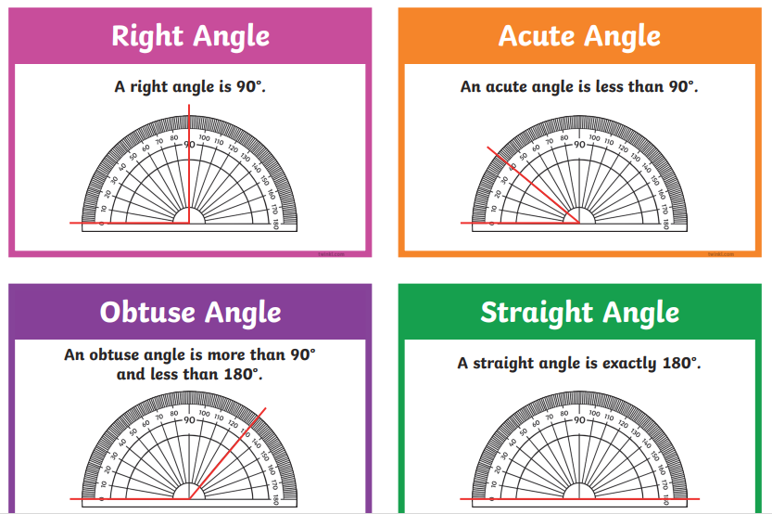
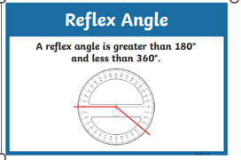
To help you

Slide 4
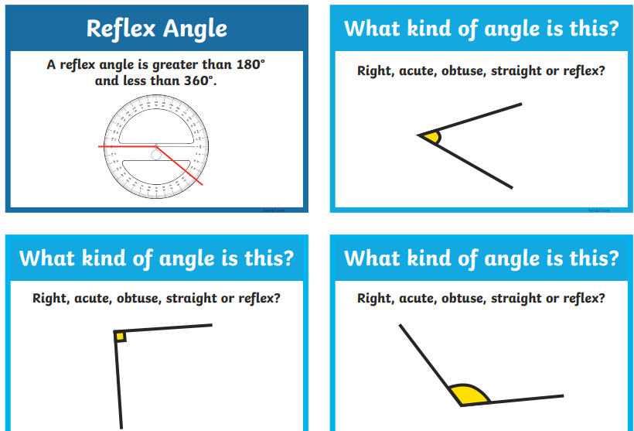
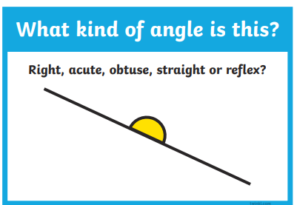
Starter questions

Slide 5
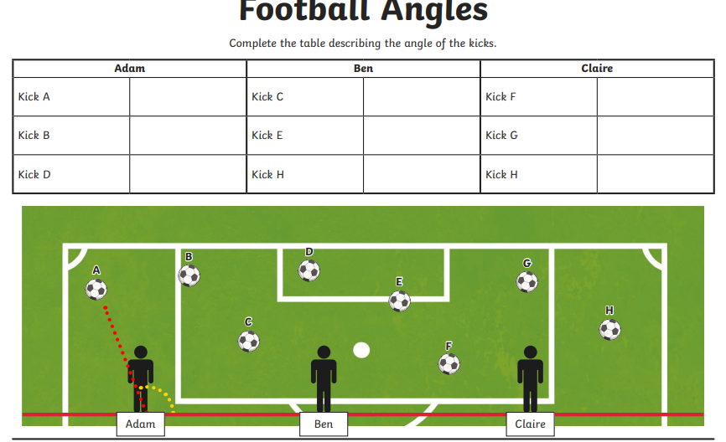
Extension: Draw a line from the player to the ball. Now look at the angle that is created from the red line at the bottom to your line. Decide if that is an acute, an obtuse or a right angle. Fill in the grid with your answers

