Slide 1


Welcome to Year 1

Slide 2
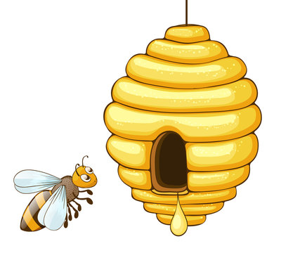
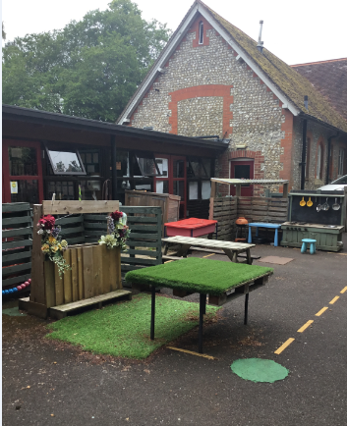
In September I will start Year 1
My class is called Honey Bee class.
This is my classroom where I will learn with my friends
This is the outside area I will sometimes use for learning

Slide 3
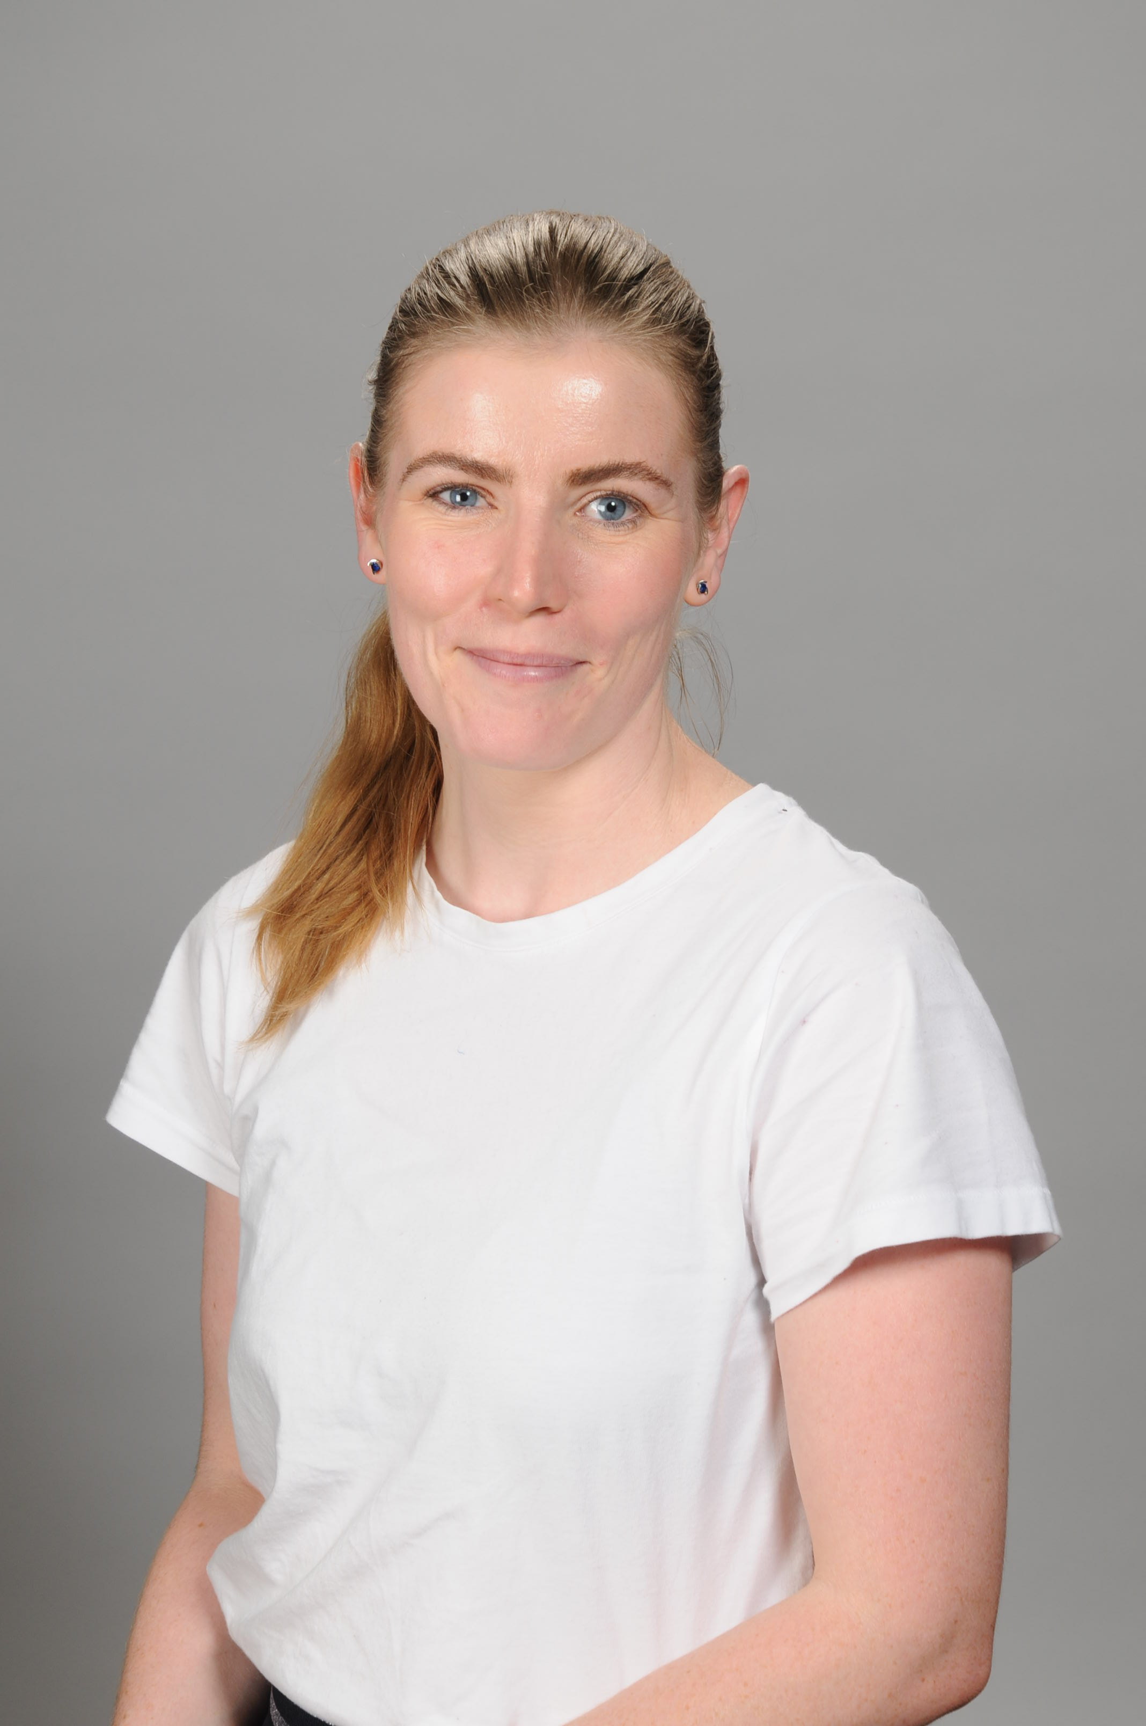
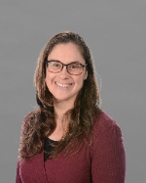
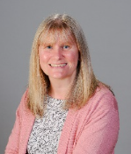
My teacher will be
These adults will also be in
Honey Bee class
Mrs Lea
Mrs Duddridge
Mrs Brown

Slide 4
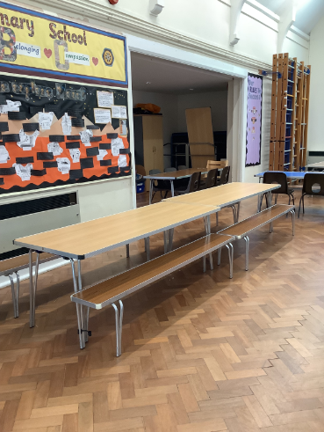
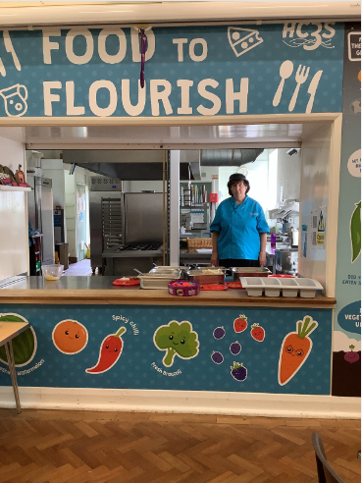
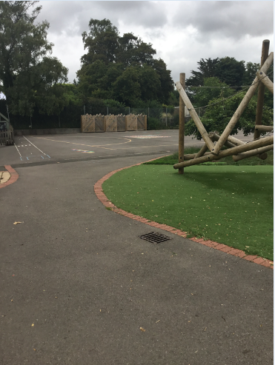
I will eat my lunch in the
hall with my friends
I will play on the playground with my
friends at playtime and lunchtime

Slide 5
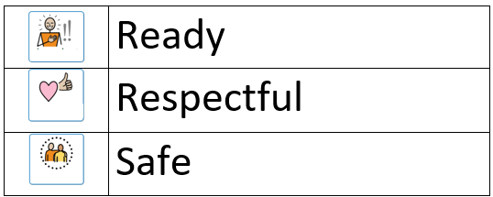
In Honey Bee Class I must follow the school rules,
they are:

Slide 6

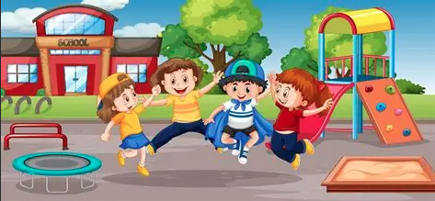
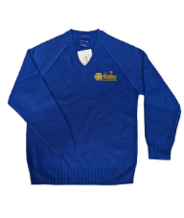
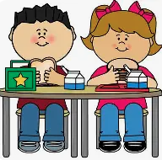

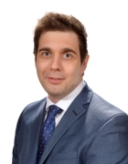
Things that will stay the same:
My class mates
The school building
The playground
My uniform
Where I eat my lunch
The length of the day
The Head Teacher

