Slide 1

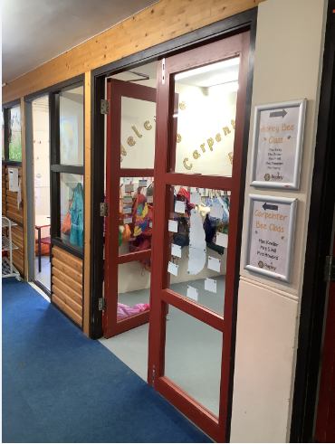
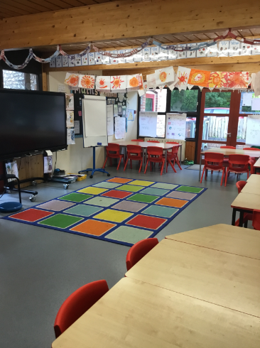

Welcome to Year 2

Slide 2
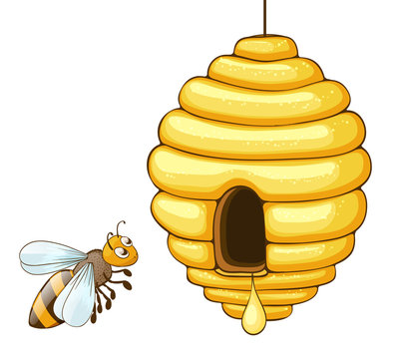
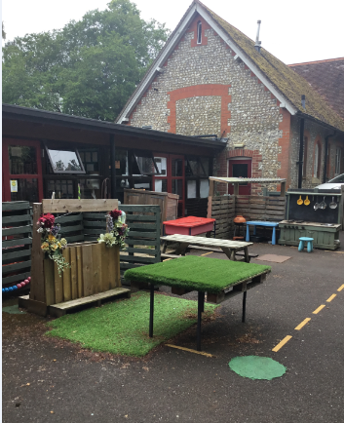
In September I will start Year 2
My class is called Carpenter Bee class.
This is my classroom where I will learn with my friends
This is the outside area I will sometimes use for learning

Slide 3
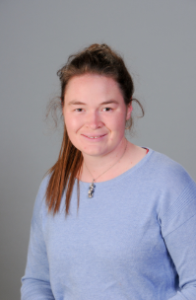
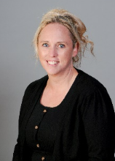
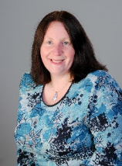
These adults will also be in
Carpenter Bee class
My teacher will be
Miss Richards
Mrs Harry
Ms Penhaligon

Slide 4
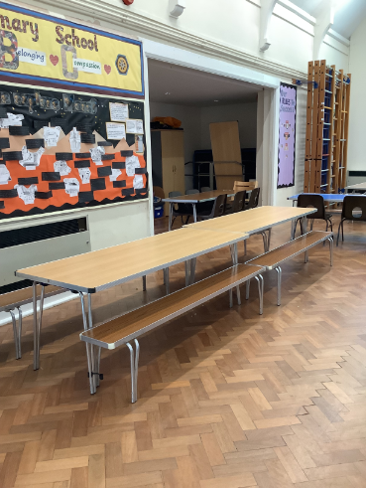
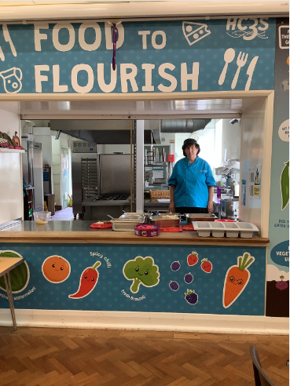
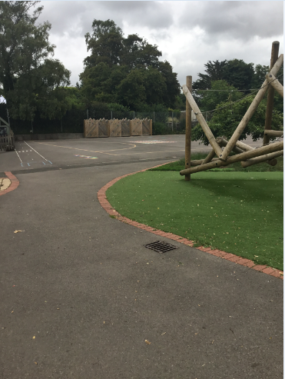
I will eat my lunch in the
hall with my friends
I will play on the playground with my
friends at playtime and lunchtime

Slide 5
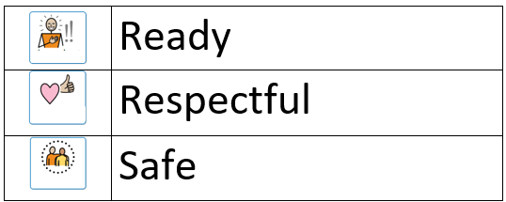
In Honey Bee Class I must follow the school rules,
they are:

Slide 6


