Slide 1

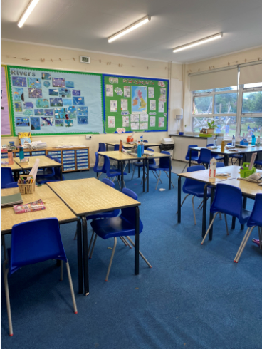

Welcome to Year 6

Slide 2
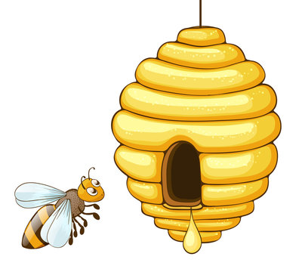

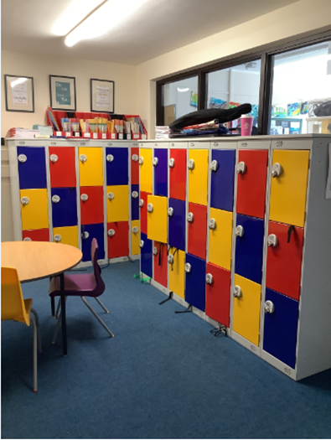
In September I will start Year 6
My class is called Bee Keeper class.
This is my classroom where I will learn with my friends, I will store my belongings in a locker outside of the classroom

Slide 3
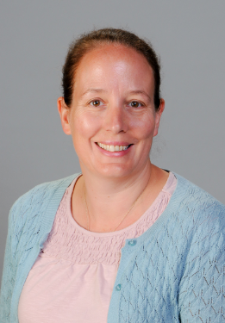
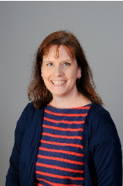
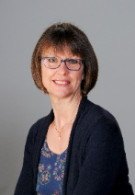
The LSA’s in Bee Keepers will be
My teacher will be
Mrs Noott
Mrs Hill
Mrs Hardie

Slide 4
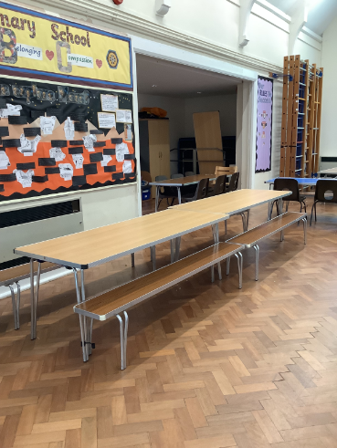
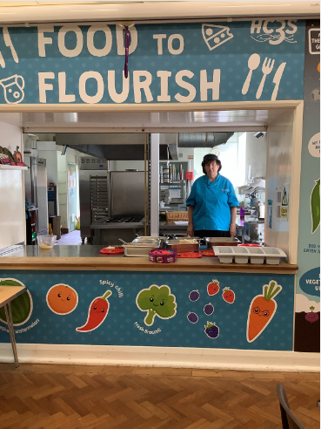
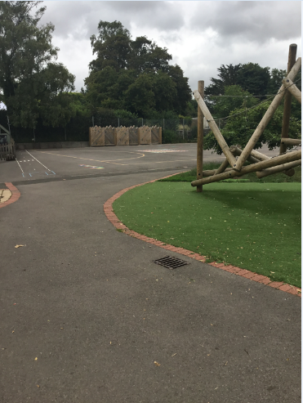
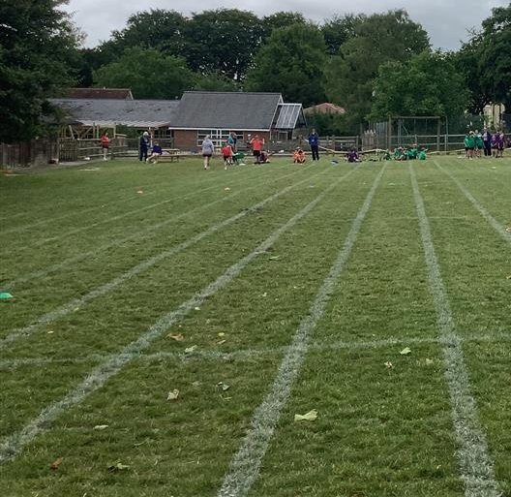
I will eat lunch in the
hall with my friends, sometimes I can eat outside
I will play on the playground and sometimes the field with my
friends at playtime and lunchtime

Slide 5
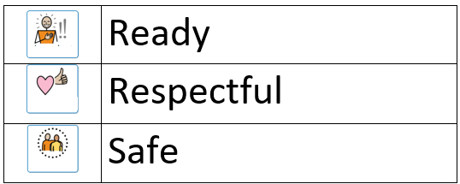
In Honeycomb Class I must follow the school rules,
they are:

Slide 6


