Slide 1

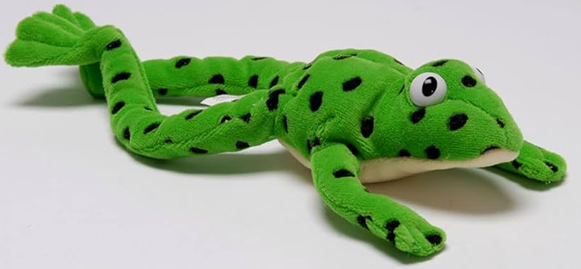
Read, Write, Inc Workshop for Bumblebee Parents

Slide 2
What is Phonics?
- Phonics is a written language.
- There are squiggles on a page that represent a sound.
- The reader must break the code – they need to decode the squiggles to read a word.

Slide 3
At five years old;
If a child is,
Never read to – 4,622 words
Read to 1 – 2 times a week – 63,570 words
Read to 3-5 times a week – 169,520 words
Read Daily – 296,000 words
Read Five books a day – 1,483,300 words
(Science daily, 2019)

Slide 4
Phonics Terminology
Phoneme – a unit of sound, for example; a-a-apple.
Grapheme – a way of writing the phoneme – a, ay, ai
Digraph – a grapheme made up of two letters making one sound (sh in fish)
Trigraph – a grapheme made up of three letters making one sound (igh in night)
Split digraph – a digraph that is split between a consonant, for example a-e in cake.

Slide 5
There are 44 sounds in the English language.
There are 26 letters of the alphabet.
There are over 150 different ways (graphemes) to represent the sounds in the English language!!
(For example, there are EIGHT ways to represent the ‘or’ sound! – or, oor, aw, au, ore, our, oar and augh)
English Language
Spanish Language
24 speech sounds
27 letters in their alphabet
29 graphemes

Slide 6
Pre-reading Skills
Listening skills in the environment
Clapping patterns
Listening for planes, helicopters, birds
Listening to different sounds, for example tapping, stamping etc.
‘Fred talk’ games
Rhyming
Sounds in words – alliteration – six sizzling sausages.
Matching pictures and initial sounds > a-a-apple, b-b-banana.
Listening to short stories, repetitive texts.

Slide 7
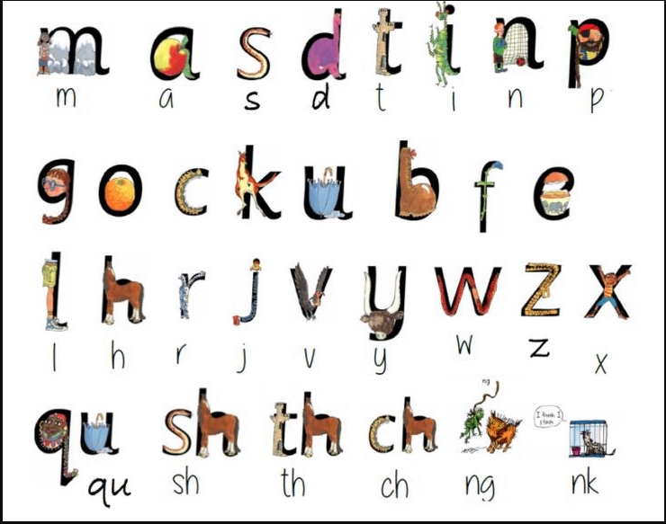
Set One Sounds
It is so important to say the pure sound. Many adults tend to add an ‘uh’ at the end.
Some sounds are ‘stretchy’ sounds – m, s, f.
Some sounds are ‘bouncy’ sounds – a, d, t.

Slide 8
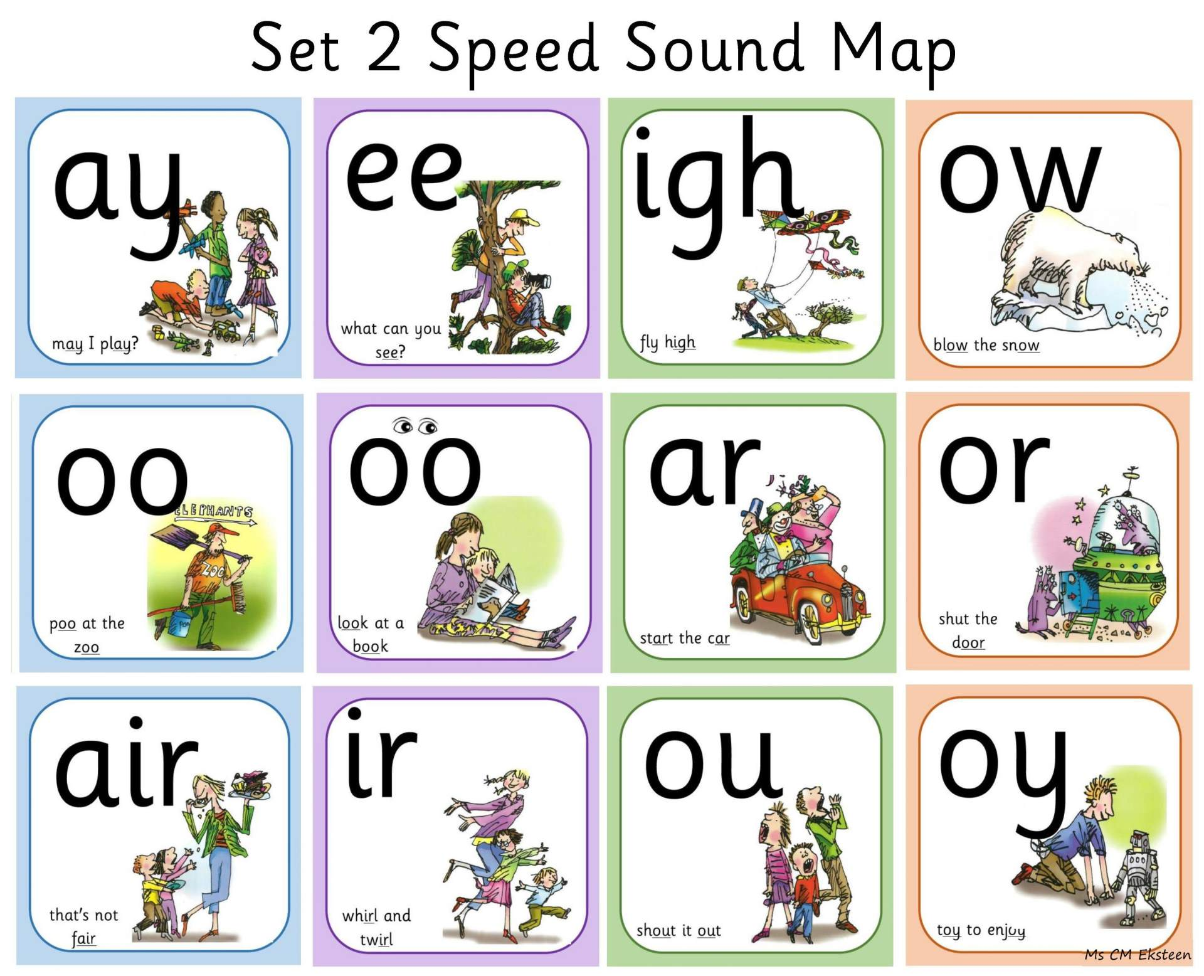
Set Two Sounds

Slide 9
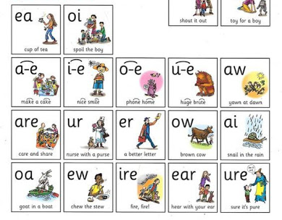
Set Three Sounds
Set three sounds are usually taught in Year One but are sometimes introduced to Year R children who are reading bigger texts, as they progress through the phonics programme.

Slide 10
Fred Words
Fred Word examples;
o-n > on c-a-t > cat sh-o-p > shop
l-igh-t > light
When reading new words, we follow the pattern of
‘special friends’ > sounds > word.

Slide 11
Red Words
Red Word examples;
the was my she by put
Red words are high frequency words, which mean they are very common in texts. Most red words you need to learn by sight, as you cannot sound them out.

Slide 12
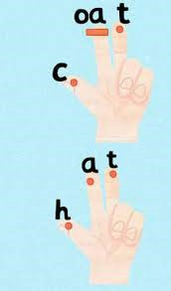
Fred Fingers
‘Fred Fingers’ help children to break down new words, hear individual sounds and supports memory development.
We use ‘Fred Fingers’ mainly to support the beginning stages of writing and to support reading skills.

Slide 13
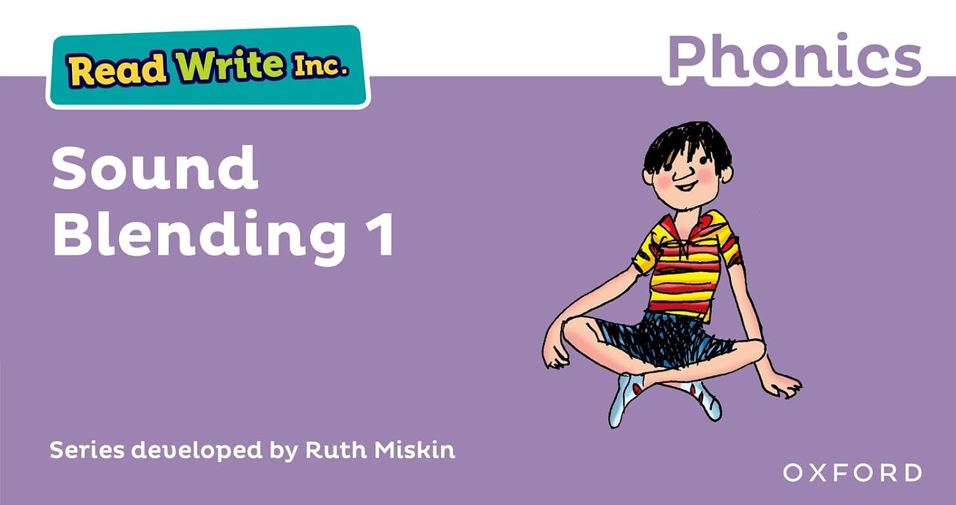
Purple Blending Books
Blending books provide children with an opportunity to practise and apply their early reading skills when reading simple CVC words, which match the sounds they have been taught in school.

Slide 14
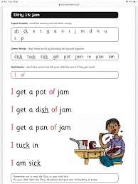
Ditty Sheets
Ditty sheets are short stories, which introduce children to reading.
Sound recap at the top. Lots of repetition with the ‘story green’ words.
Practise the ‘red’ words.
Remind the children these words are going to be in the story/ ditty.

Slide 15
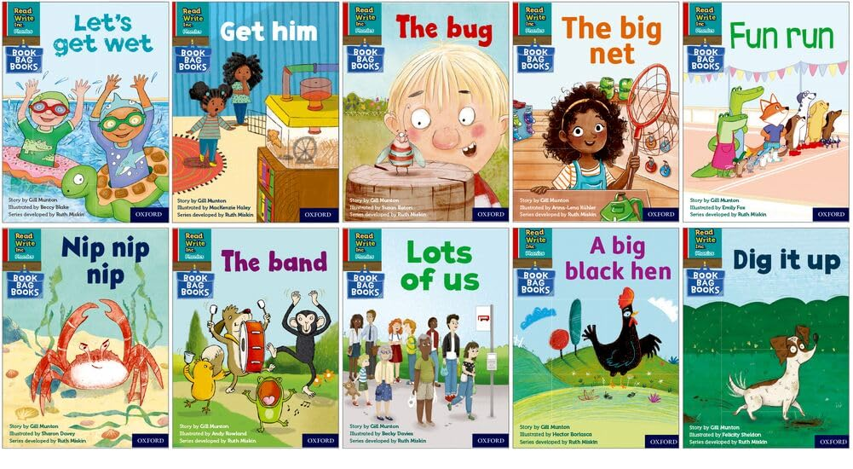
RWI Home Reading Books

Slide 16
RWI Reading Expectations
Reception Class Year (Bumblebee Class)
By Christmas:
Children can complete oral blending tasks successfully (Fred Talk)
Children to recognise most of the ‘Set One’ sounds independently and consistently.
Children can independently read some CVC words.
By Easter:
Children securely recognise all ‘Set One’ sounds, including the special friends
( sh, ch, ng, nk, th and qu).
Children can independently read CVC words and words that contain ‘Set One’ special friend sounds.
By Summer:
Children can recognise several ‘Set Two’ special friend sounds.
Children can read sentences independently in stories which match their phonics level and with greater fluency.
Children can recognise and read some high frequency words (red words) independently in their texts. For example; ‘I’, ‘of’, ‘my’, ‘the’, ‘she’, ‘he’, ‘was’.

Slide 17
RWI Home Reading Expectations
Reception Class Year (Bumblebee Class)
At Ropley, we expect children to read at least FIVE times a week with a grown-up at home.
By Christmas
Reading Ditty Sheets
By Easter
Red Ditty Books
By Summer
Green/ Purple Home Reading Books
Please remember every child learns at their own pace.

Slide 18
How to support reading at home
Regular reading skill practice – short sessions.
Practical games, such as;
Bingo
Snap
Word/ sound hunt
Incorporate interests, e.g bounce a ball on a sound, word.
Flash cards
Sound/ word spotting in the environment
Word searches
Word matching

